Slide 1
CRM SALES FORCE
REPORT ANALYSIS

Slide 2
INTRODUCTION
Salesforce is a cloud-based Customer Relationship Management (CRM) platform that enables businesses to manage customer data, sales operations, and marketing campaigns. It provides various features, and tools businesses can use to improve customer relationships, including customer segmentation, customer data management, and customer support. Salesforce also offers a variety of integrations with third-party applications and services, making it a powerful and versatile CRM platform.

Slide 3


TOOLS USED
EXCEL
TABLEAU

Slide 4
Opportunity(KPIs)
Expected Amount
Active Opportunities
Conversion Rate
Win Rate
Loss
Trend Analysis
Running Total Expected Vs Commit Forecast Amount over Time
Running Total Active Vs Total Opportunities over Time
Closed Won Vs Total Opportunities over Time
Closed Won vs Total Closed over Time
Expected Amount by Opportunity Type
Opportunities by Industry

Slide 5
Lead(KPIs)
Total Lead
Expected Amount from Converted Leads
Conversion Rate
Converted Accounts
Converted Opportunities
Lead By Source
Lead By industry

Slide 6
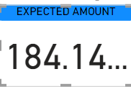
KPI 1
EXPECTED AMOUNT

Slide 7
KPI
ACTIVE OPPORTUNITIES
ACTIVE OPPORTUNITIES
1272
CONVERSION RATE
Conversion Rate
10.33%
WIN RATE
31.06%
WIN RATE

Slide 8
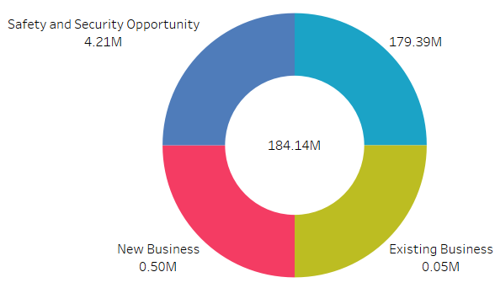
KPI
LOSS
EXPECTED AMOUNT BY
OPPORTUNITY TYPE
LOSS
1.93K

Slide 9
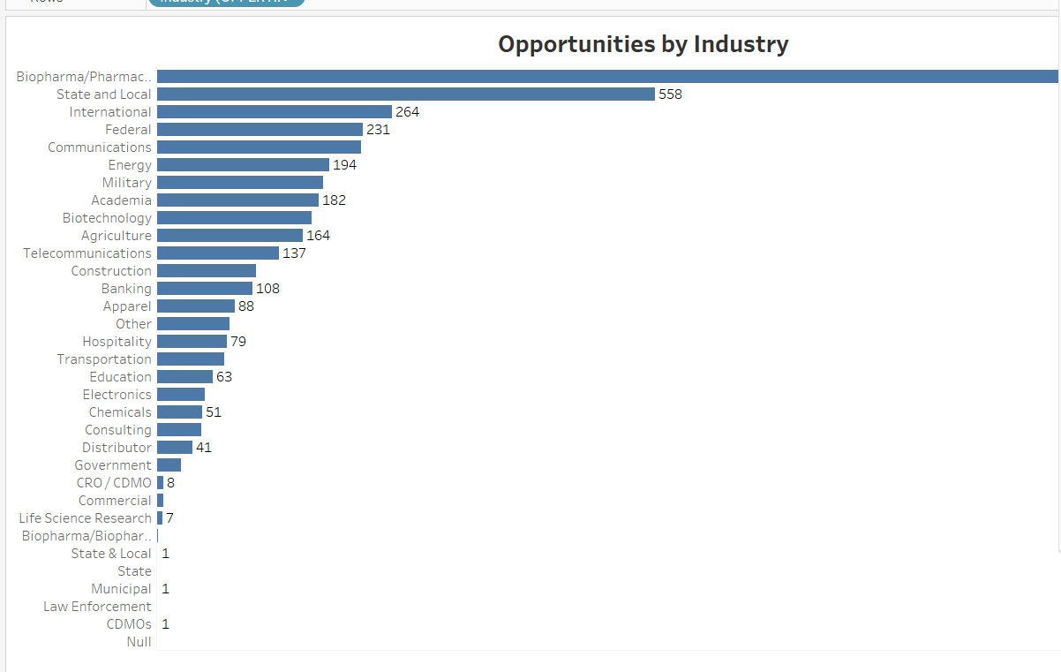
KPI
OPPORTUNITIES BY INDUSTRY

Slide 10
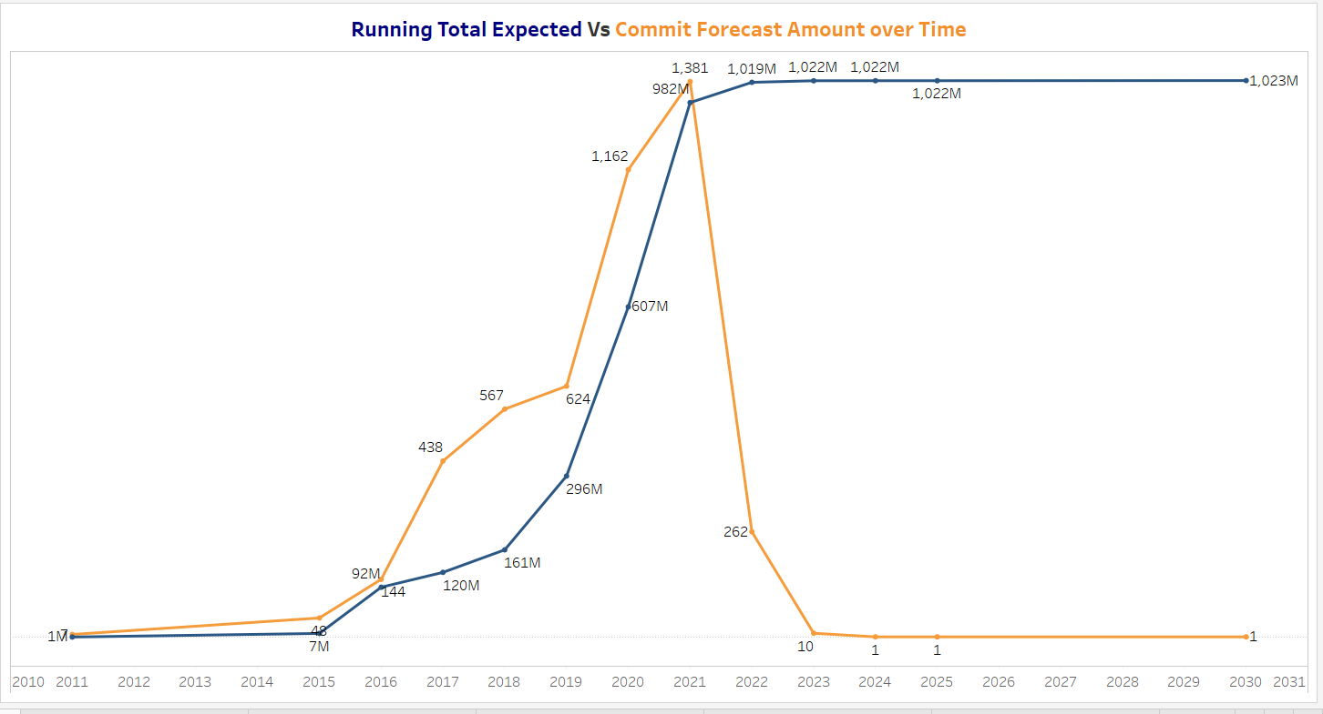
TREND ANALYSIS
Running Total Expected VS Commit Forecast Amount over time

Slide 11
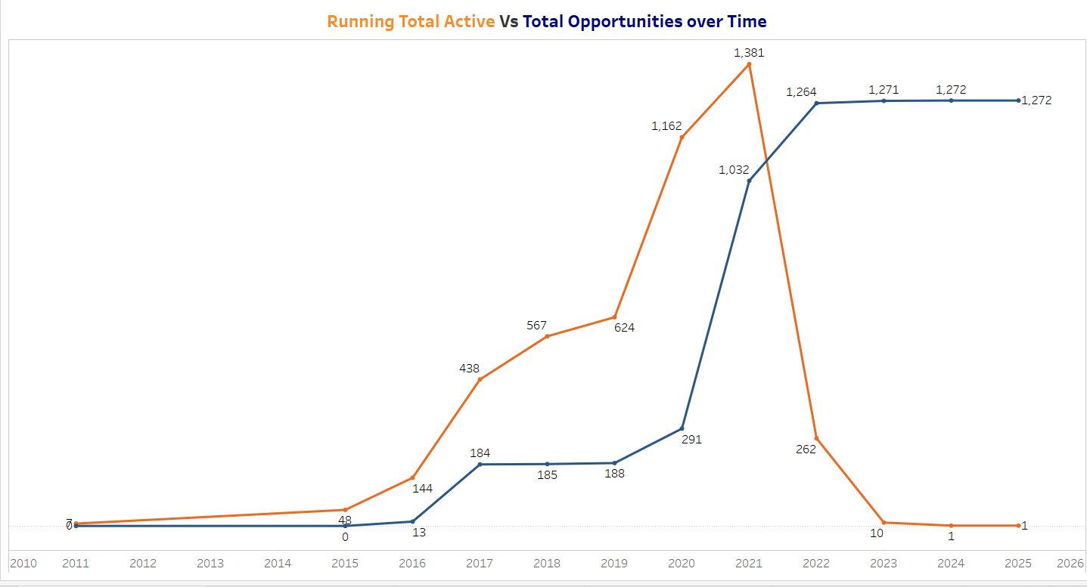
Running Total Active Vs Total Opportunities Over Time

Slide 12
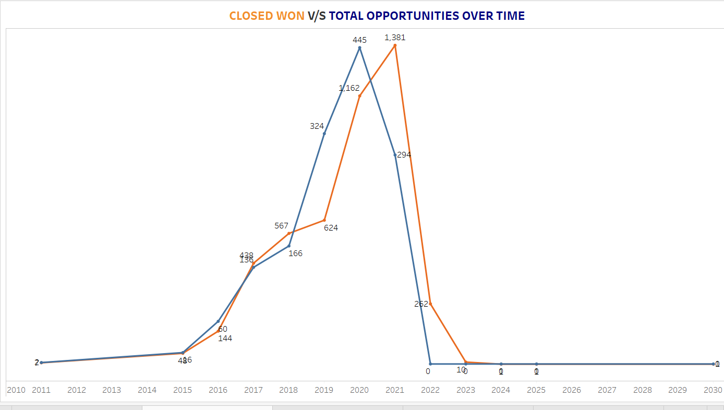
Closed Won Vs Total Opportunities Over Time

Slide 13
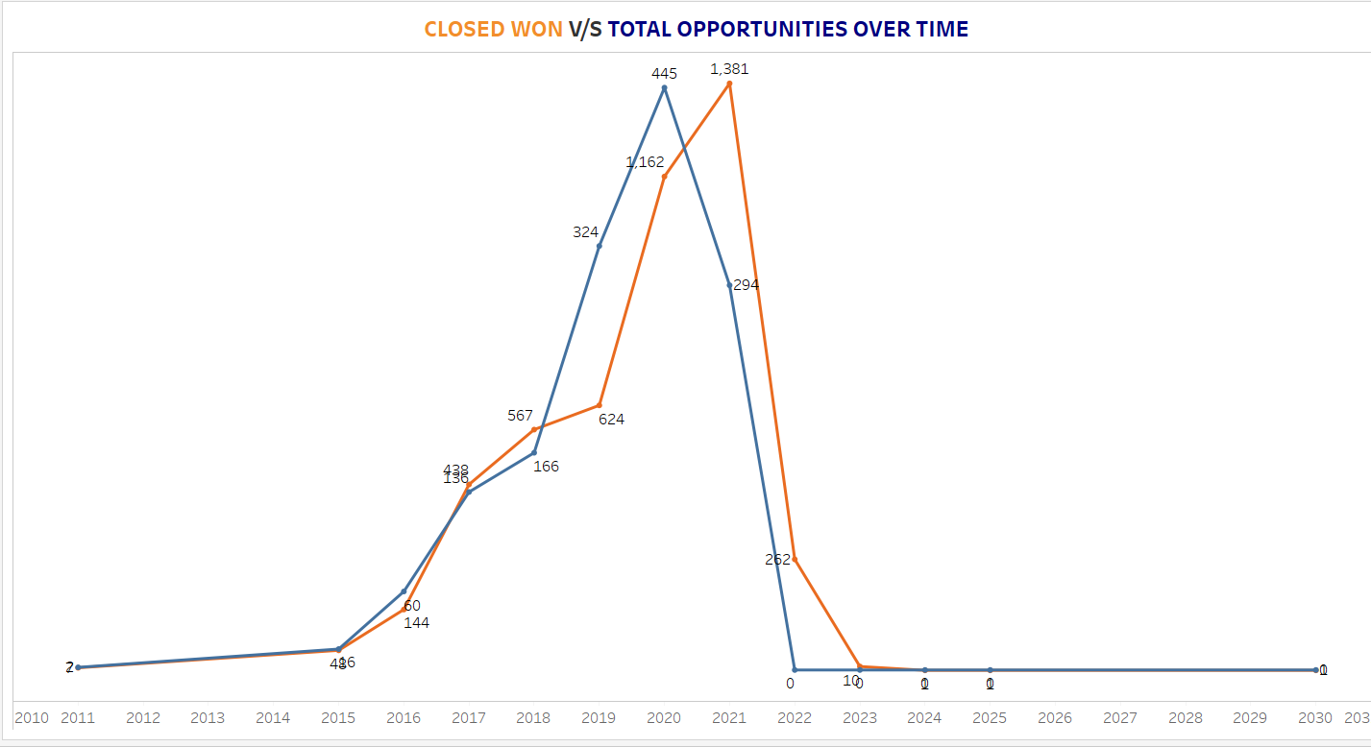
Closed Won Vs Total Closed Over Time

Slide 14
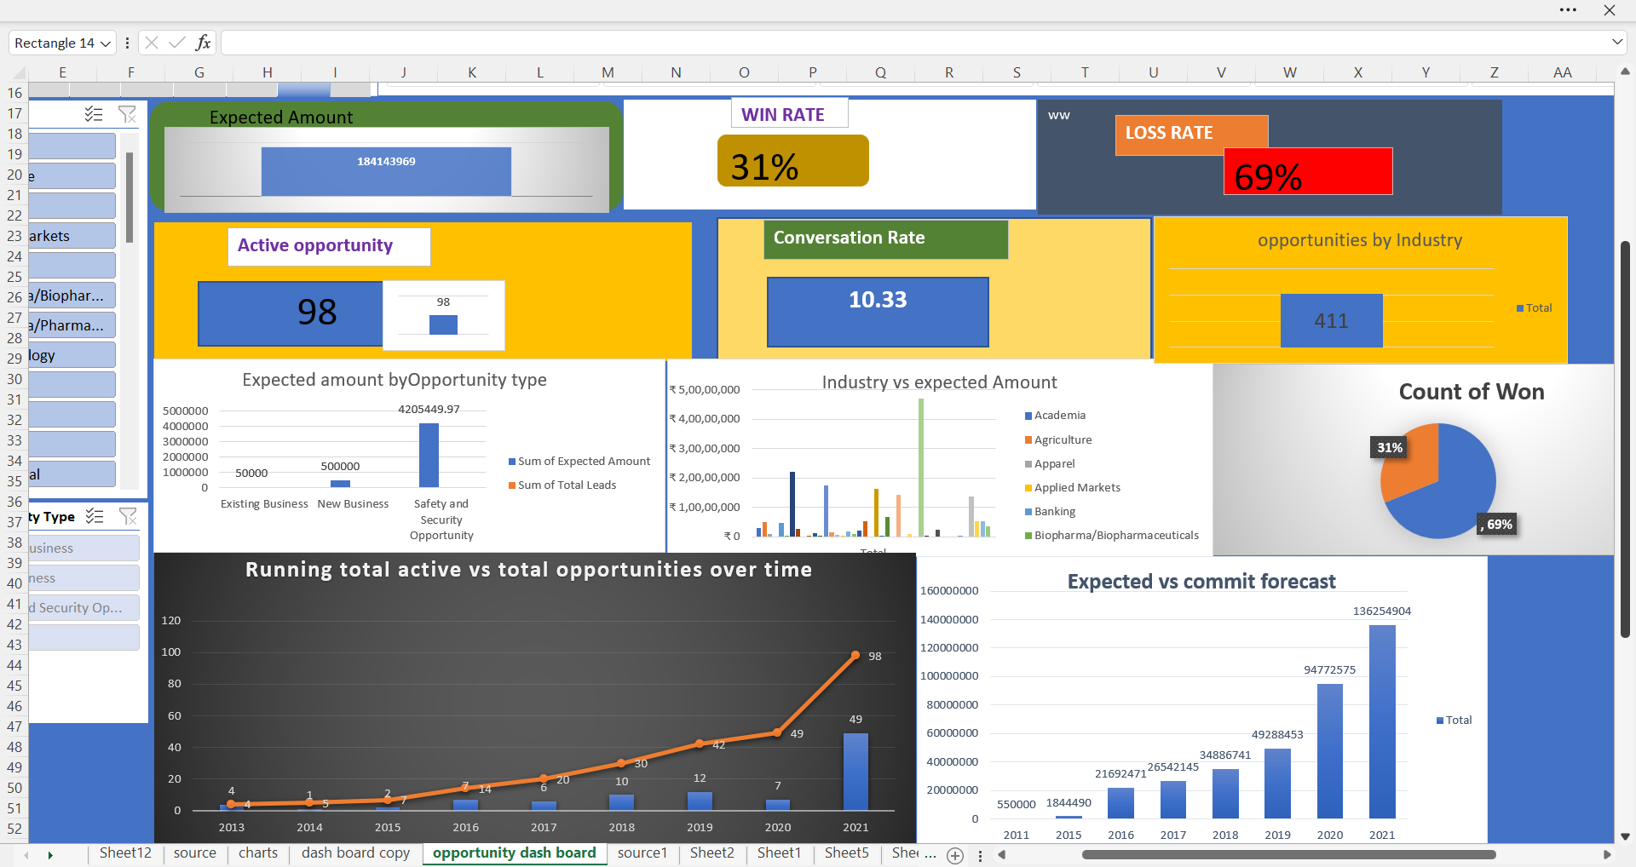
OPPORTUNITY DASH BOARD EXCEL

Slide 15
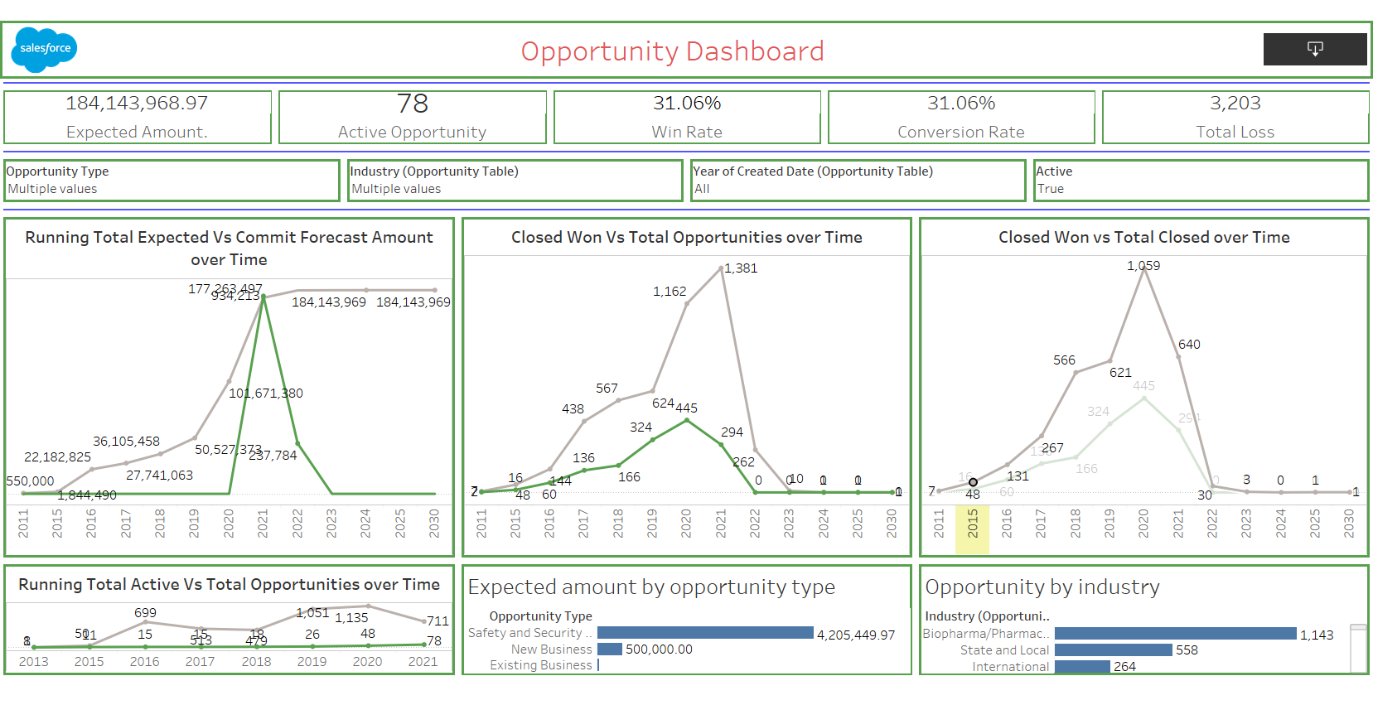
OPPORTUNITY DASH BOARD TABLEAU

Slide 16
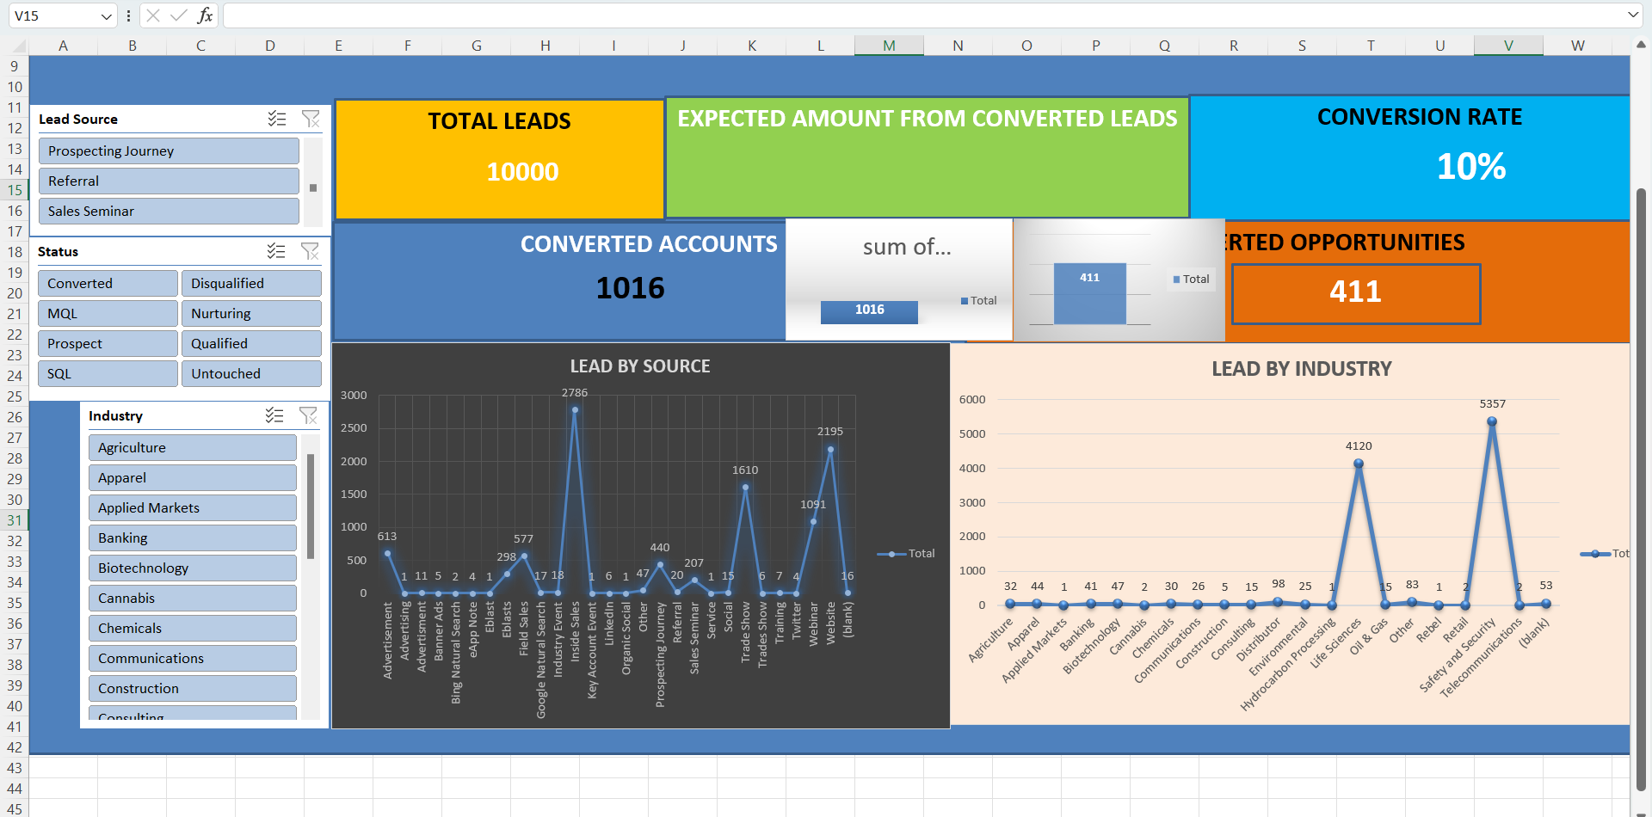
LEAD DASH BOARD EXCEL

Slide 17
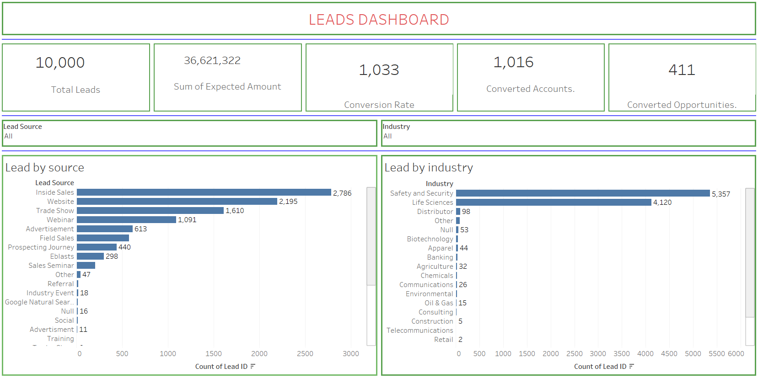
LEAD DASH BOARD TABLEAU

Slide 18
CONCLUSION
Created Dash Board on opportunity table and Lead table
Created reports based on my knowledge using excel ,BI tools Tableau

Slide 19
THANK YOU

